Slide 1
New & Noteworthy Project Update:
PHP IDE
Presented By:
Yossi Leon, Project Leader

Slide 2
What is PHP?
Definition: PHP: Hypertext Preprocessor
A language based on a rewrite of PHP/FI, started in 1997 by Andi Gutmans and Zeev Suraski
Designed from the ground up for creating Web applications
Easy to use
23 million domains using PHP
4.6 million PHP programmers (estimated by Evans Data)
37 percent annual increase expected by 2007

Slide 3
PHP IDE Overview
PHP IDE is a PHP Integrated Development Environment for developing, debugging and managing PHP files
PHP IDE architecture based on WTP
Downloads: More than 800 downloads per day
PHP IDE modules:
  Core – parser, search algorithm, communication and more
  Debug – protocols, messages, executable and web server
  UI – Editor, views, preferences and wizards
Notes:
Apps provides views in a workbench provided perspective and are largely controlled by the workbench
Components like ui.workbench and SWT and JFace have been subsetted. Full eRCP runtime is only a 2.5MB download.
Plugins like core.runtime and osgi can now run on Foundation.

Slide 4
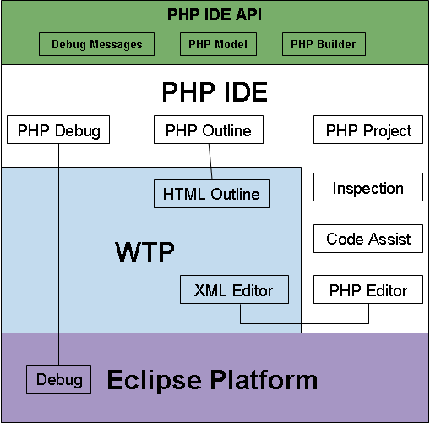

Slide 5
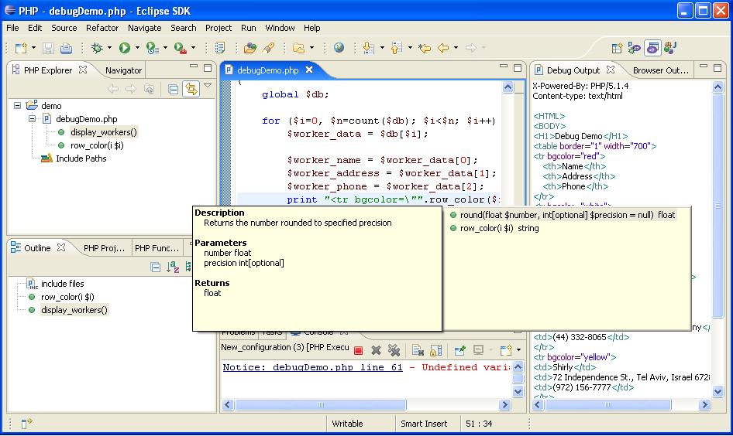
DEMO
Notes:
A move up from MIDP in providing richer function
Allows Eclipse developers to use their knowledge and experience on devices

Slide 6
PHP IDE Schedule
March 8, 2006 - Creation review
March 20-23, 2006 - EclipseCon: Presenting PHP IDE
April, 2006 - Finish 3rd development stage
July, 2006 - Upgrade to Eclipse 3.2 and WTP 1.5
October 12, 2006 - Eclipse Summit: Presenting PHP IDE
November, 2006 - Include Path UI & bug fixes
December, 2006 - Debugger infrastructure improvements
December, 2006 - PHP IDE 0.7 release
January, 2007 - Code Formatter development
February, 2007 - Parser and syntax highlighter changes
June, 2007 - PHP IDE 1.0 release

Slide 7
Thank You! http://www.eclipse.org/php/ http://download.eclipse.org/tools/php/updates/

